Slide 1
Hilbert’s 1927 Program
and John Searle’s Chinese Room

Slide 2

Haircuts during COVID
The hairdresser is the "one who cuts hair for all those, and only those, who do not cut their own hair".
So….. can the hairdresser cut her own hair?

Slide 3
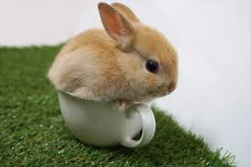
Here’s a famous paradox...
A set is a collection of distinct objects.

Slide 4
Here’s a famous paradox...
A set is a collection of distinct objects.
Let R be the set of all sets that are not members of themselves.

Slide 5
Here’s a famous paradox...
A set is a collection of distinct objects.
Let R be the set of all sets that are not members of themselves.
For example, let T be the set of all teacups.
Each member of T is a teacup.
Is T a member of T?
Is (the set of all teacups) a (teacup)?
T is not a member of T
(and hence T is a member of R)

Slide 6
Here’s a famous paradox...
A set is a collection of distinct objects.
Let R be the set of all sets that are not members of themselves.
For example, let S be the set of all non-teacups.
Each member of S is not a teacup.
Is S a member of S?
Is (the set of all non-teacups) not a (teacup)?
S is a member of S
(and hence S is NOT a member of R)

Slide 7
Here’s a famous paradox...
A set is a collection of distinct objects.
Let R be the set of all sets that are not members of themselves.
So is R a member of itself?

Slide 8
Here’s a famous paradox...
A set is a collection of distinct objects.
Let R be the set of all sets that are not members of themselves.
So is R a member of itself?
True - If it is a member of itself then it shouldn’t have been in a set that are not members of themselves to begin with
False - If it is not a member of itself then it fulfills the criteria of being a member of itself

Slide 9
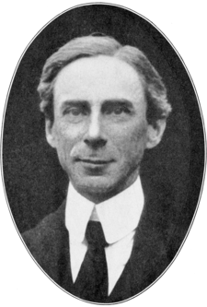
Here’s a famous paradox...
A set is a collection of distinct objects.
Let R be the set of all sets that are not members of themselves.
So is R a member of itself?
True - If it is a member of itself then it shouldn’t have been in a set that are not members of themselves to begin with
False - If it is not a member of itself then it fulfills the criteria of being a member of itself
Russell’s Paradox!!

Slide 10
Can you see the relation to...
The hairdresser is the "one who cuts hair for all those, and only those, who do not cut their own hair".
So….. can the hairdresser cut her own hair?

Slide 11
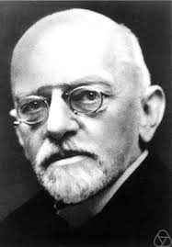
Hilbert’s 1927 Program
In the early 20th century, there was a crisis in mathematics when certain logical paradoxes were discovered (e.g. Russell’s Paradox)
David Hilbert was a very influential German mathematician from the late 19th and early 20th centuries.

Slide 12
Hilbert’s 1927 Program
Hilbert wanted to know if mathematics was:
Complete:
All mathematical statements could be derived from a finite set of axioms
Consistent:
No contradictions could exist
Decidable:
There was a single algorithm for deciding the truth of any mathematical statement

Slide 13
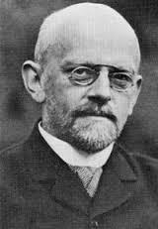
Hilbert’s 1927 Program
He proposed the idea that all of mathematics could be explained through use of axioms, or more specifically:
All of Mathematics follows from a correctly chosen finite set of axioms
That some such axiom system is provably consistent through some means.
This was the idea behind Hilbert’s “program” (it wasn’t a computer program!)

Slide 14

Axioms
An Axiom is a statement or proposition which is regarded as being established, accepted, or self-evidently true.

Slide 15
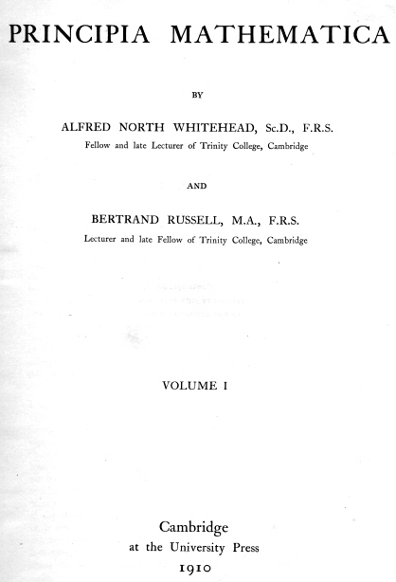
Axioms
Five example axioms
1. ∀a: ~Sa = 0
2. ∀a: (a + 0) = a
3. ∀a:∀b: (a + Sb) = S(a + b)
4. ∀a: (a · 0) = 0
5. ∀a:∀b: (a · Sb) = ((a · b) + a)
Axiom 3 means: a + (b + 1) = (a + b) + 1
Axiom 5 means: a (b + 1) = ab + a
Notes:
Limits of Logic: The Gödel Legacy
https://www.youtube.com/watch?v=V9ohtKameio
∀a means “for all a”
Sa means “successor” of a (ie. a + 1)
~ means not

Slide 16

1 + 1 = ??
∀a:∀b: (a + Sb) = S(a + b) axiom 3
∀b:(S0 + Sb) = S(S0 + b) S0 for a
(S0 + S0) = S(S0 + 0) 0 for b
∀a: (a + 0) = a axiom 2
(S0 + 0) = S0 S0 for a
S(S0 + 0) = SS0 add S
(S0 + S0) = SS0 lines 3, 6
1 + 1 = 2
Notes:
Limits of Logic: The Gödel Legacy
https://www.youtube.com/watch?v=V9ohtKameio
∀a means “for all a”
Sa means “successor” of a (ie. a + 1)
~ means not

Slide 17
Hilbert’s 1927 Program
The idea behind Hilbert’s Program was that if we could express the very foundations of mathematical reasoning in terms of base axioms the any complex mathematical theory could then be reduced to these axioms also and thus proven to be consistent.
Hilbert’s program was thus an attempt to find the finite set of axioms that described the base logic of all mathematical reasoning.

Slide 18
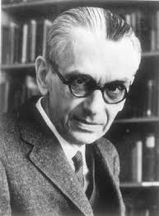
Gödel’s Spanner in the works
Kurt Gödel later threw a metaphorical spanner in Hilbert’s idea when he demonstrated that a system of axioms could not demonstrate its own consistency and thus Hilbert’s Program would never be possible.
This was known as Godel’s incompleteness theorem.
The following provides an informal intuition of Gödel’s incompleteness theorem.

Slide 19
The supreme master of Logic
Imagine….
There is an supreme master of logic.
You can present any logical statement to him.
And using purely logic, he will always correctly state whether it is TRUE or FALSE.

Slide 20

The supreme master of Logic
Let’s call him Mr Trump
Imagine….
There is an supreme master of logic.
You can present any logical statement to him.
And using purely logic, he will always correctly state whether it is TRUE or FALSE.

Slide 21
The supreme master of Logic
“One plus one equals four”

Slide 22
The supreme master of Logic
“One plus one equals four”
“FALSE”

Slide 23
The supreme master of Logic
“A disjunction can be a tautology, even if one of its disjunctions is a contradiction”

Slide 24
The supreme master of Logic
“A disjunction can be a tautology, even if one of its disjunctions is a contradiction”
“TRUE”

Slide 25
The supreme master of Logic
Is there a statement that YOU could know the answer to, but would utterly stump Mr Trump???

Slide 26
The supreme master of Logic
“Mr Trump, you cannot prove this statement is true.”

Slide 27

The supreme master of Logic
“Mr Trump, you cannot prove this statement is true.”

Slide 28
The supreme master of Logic
“Mr Trump, you cannot prove this statement is true.”
Notice...
You can prove the truth of this statement.
BUT Mr Trump, the supreme master of logic, CANNOT.
Why???

Slide 29
Gödel’s Spanner in the works
Gödel’s formal incompleteness theorem involved encoding axioms, formulas, and theorems into numbers.
Godel’s formula G, whose encoded number is g, says:
The number g is not the number of a theorem..

Slide 30
Gödel’s Spanner in the works
Gödel’s formal incompleteness theorem involved encoding axioms, formulas, and theorems into numbers.
Godel’s formula G, whose encoded number is g, says:
The number g is not the number of a theorem..
“Mr Trump, you cannot prove this statement is true.”

Slide 31
Gödel’s Spanner in the works
However, Hilbert’s ideas could be applied to other aspects of mathematics.
Combined with Gödel’s work, this led to the formation of recursion theory which as we now know is the basis of computer science…

Slide 32
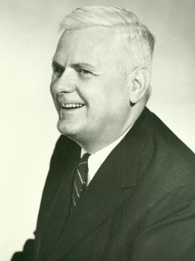
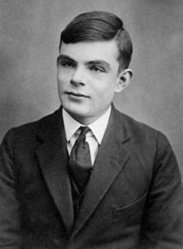
Church and Turing’s Spanner in the works
… including what was to become the Church-Turing thesis which provided the final nail in Hilbert’s original program.
Recall the Church-Turing thesis stated that mathematical functions are only calculable if they can be computed by a Turing machine.
By proving that the Halting problem was undecidable and hence not computable by a Turing machine, by the Church-Turing thesis, this also disproved the decidability of mathematics.

Slide 33
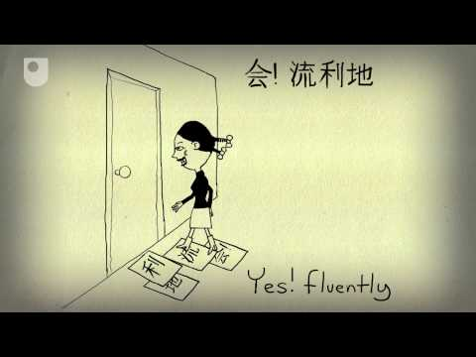
John Searle’s Chinese Room

Slide 34
John Searle’s Chinese Room
Imagine a native English speaker who knows no Chinese locked in a room full of boxes of Chinese symbols (a data base) together with a book of instructions for manipulating the symbols (the program). Imagine that people outside the room send in other Chinese symbols which, unknown to the person in the room, are questions in Chinese (the input). And imagine that by following the instructions in the program the man in the room is able to pass out Chinese symbols which are correct answers to the questions (the output). The program enables the person in the room to pass the Turing Test for understanding Chinese but he does not understand a word of Chinese.

Slide 35
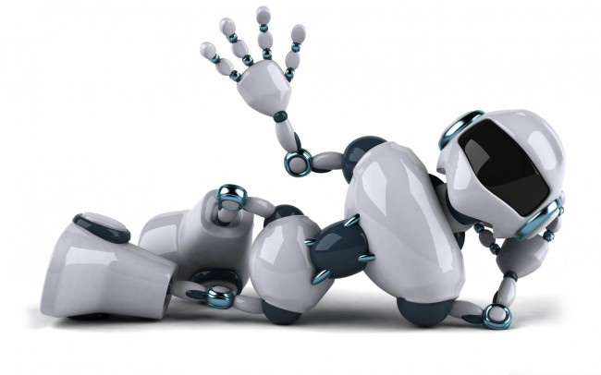
John Searle’s Chinese Room
John Searle’s Chinese Room argument is really about determining the level of Artificial Intelligence. Strong AI implies that the AI actually understands what it is doing whereas weak AI it is just following rules, similar to what John was doing inside the Chinese Room, and so no level of understanding of what is going on is necessary.
There is still much debate about the outcome of this
thought experiment though:

Slide 36
John Searle’s Chinese Room
Arguments For Strong AI:
Some people argue that while the person within the room might not understand Chinese, the whole system could be argued to understand Chinese. It is akin to saying that while an individual neuron in your brain doesn’t understand English, the combination and system of all the neurons together do. (This is known as the systems reply)
Some people agree that Searle’s Chinese Room does demonstrate a case of weak AI (it understands the syntax but not the semantics) but that it is still possible to create a different system that would have strong AI through use of other sensory inputs or motors or be a simulation of an entire brain (neuron by neuron). This is known as the Robot Reply.

Slide 37

John Searle’s Chinese Room
Arguments for Strong AI:
Some people refute the entire idea of the Chinese room and suggest that ‘understanding’ as Searle has suggested is not definitive enough and that we should be willing to assign understanding based on observed behaviour, in a similar way that we could say and animal or alien species ‘understands’ something.
How do we ‘know’ that Searle himself is intelligent? We conclude based on observing his behaviour (i.e. he passes the Turing test). Why should the Chinese Room, then, be held to a higher standard.?

Slide 38
John Searle’s Chinese Room
Arguments For Weak AI:
In response to the system’s reply, Searle has suggested that the person inside the room can actually memorise all of the instructions in the room and thus leave the room and still be able to respond in the same manner, thus leaving the ‘system’ behind but still managing without actually understanding what is going on.
In response to the robot reply, Searle suggests that ultimately the signals coming in from the sensors of the robot are fundamentally binary digits that are encoded in a way that requires specific rules to be decoded. They are not ‘understood’ in the way that conscious beings perceive the world.

Slide 39
John Searle’s Chinese Room
Arguments For Weak AI:
3. Searle argues that any system that simulates intelligent behaviour or understanding does not necessarily understand what it is doing and that ultimately, all intelligent behaviour must stem from biological processes.

Slide 40
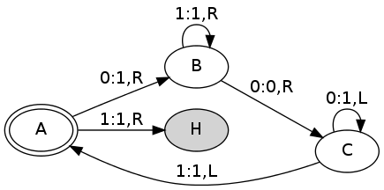
Activity
What is the output of this Turing machine given an input of:
0 | 0 | 0 | 0 | 0
Start here

Slide 41
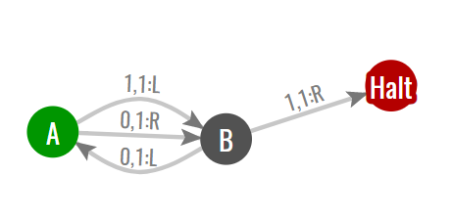
2-State Busy Beaver
What is the output of this Turing machine given an input of:
0 | 0 | 0 | 0 | 0

